Slide 1
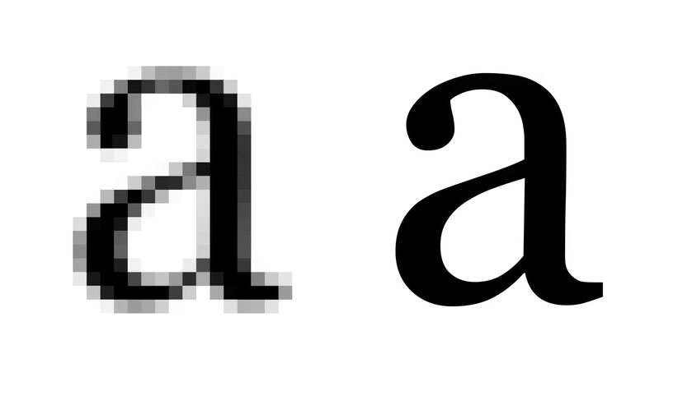
Image Processing & Antialiasing
Part I (Overview and Examples)
Notes:
Image from http://www.gadgetell.com/tech/comment/apple-officially-announces-iphone-4/

Slide 2
Image Processing & Antialiasing
An entire subject in and of itself undergirds both computer graphics and computer vision
Has its own publications and conferences
IEEE Transactions on Image Processing (TIP)
Image and Vision Computing
Journal of Electronic Imaging
IEEE International Conference on Image Processing (ICIP)
Once was closer to signal theory and audio processing than to graphics
Shares hardware with other aspects of graphics
Floating point processors (FPUs)
Digital signal processors (DSPs)
Framebuffers
Scanners
Digital cameras
Color printers
Video frame grabbers/converters
Notes:
Source for Image Processing Pubs/Confs:
http://www.imageprocessingplace.com/root_files_V3/publications.htm#journals
http://iris.usc.edu/Information/Iris-Conferences.html

Slide 3
Outline
Overview
Example Applications
Jaggies & Aliasing
Sampling & Duals
Convolution
Filtering
Scaling
Reconstruction
Scaling, continued
Implementation

Slide 4
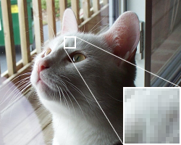
What does “image” mean for us?
A 2D domain with samples at regular points (almost always a rectilinear grid)
Can have multiple samples per point
Meaning of samples depend on the application (red, green, blue, opacity, depth, etc.)
Units also depend on the application
e.g., an int or float to be mapped to voltage needed for display on a screen (e.g. a BMP file)
e.g., as a physical measurement of incoming light (e.g., a camera sensor)
Introduction to sampling demo

Slide 5
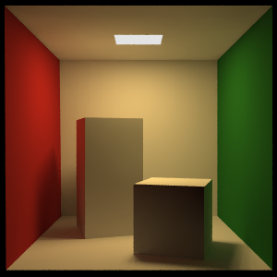
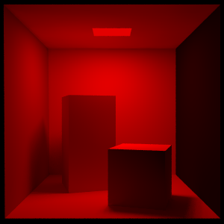
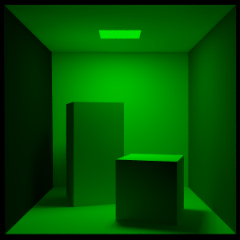
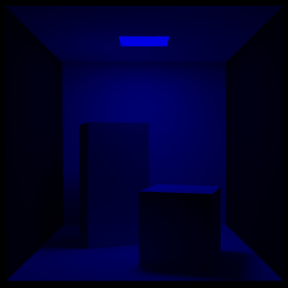
What is a channel?
Original RGB image
3 samples per pixel
A channel is all the samples of a particular type
The red channel of an RGB image is an image containing just the red samples
TV channels are tuned to different frequencies of electromagnetic waves
In a similar sense, RGB channels are “tuned” to different frequencies in the visible spectrum
Red channel
1 sample per pixel
Green channel
1 sample per pixel
Blue channel
1 sample per pixel

Slide 6
The alpha channel
In addition to the R, G, and B channels of an image, add a fourth channel called α (transparency/opacity/translucency)
Alpha varies between 0 and 1
Value of 1 represents a completely opaque pixel, one you cannot see through
Value of 0 is a completely transparent pixel
0< α < 1 => translucency
Useful for blending images
Images with higher alpha values are less transparent
Linear interpolation (αR + (1- α)B) or full Porter-Duff compositing algebra
The red box is drawn on top of the blue box using α = 0.8

Slide 7
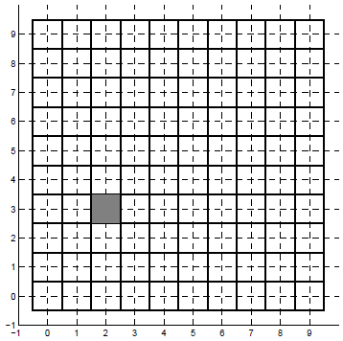
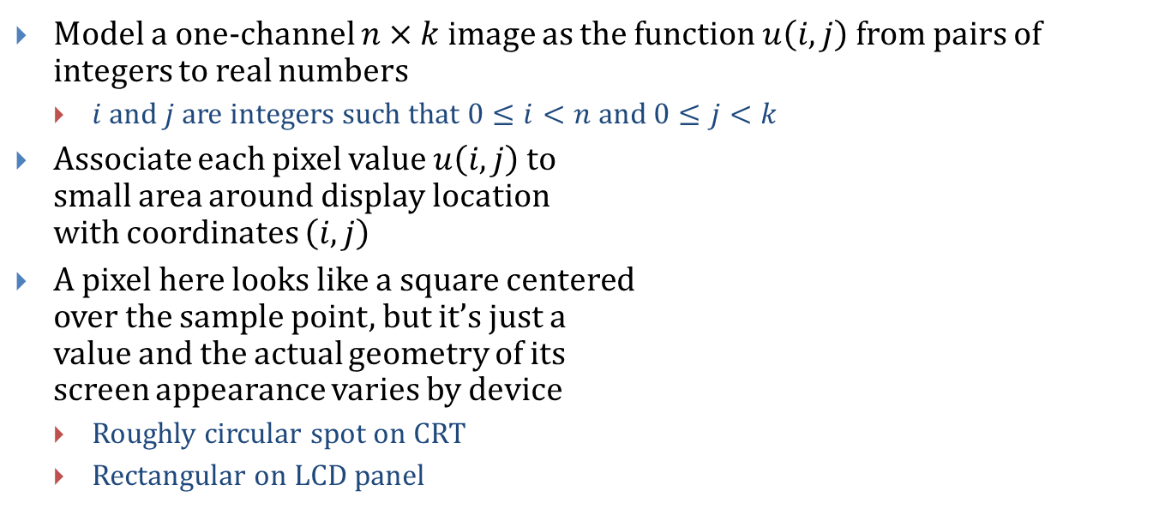
Modeling an image
Model a one-channel $n×k$ image as the function $u\left(i,j\right)$ from pairs of integers to real numbers
$i$ and $j$ are integers such that $0≤i<n$ and $0≤j<k$
Associate each pixel value $u\left(i,j\right)$ to small area around display location with coordinates $\left(i,j\right)$
A pixel here looks like a square centered over the sample point, but it’s just a value and the actual geometry of its screen appearance varies by device
Roughly circular spot on CRT
Rectangular on LCD panel

Slide 8
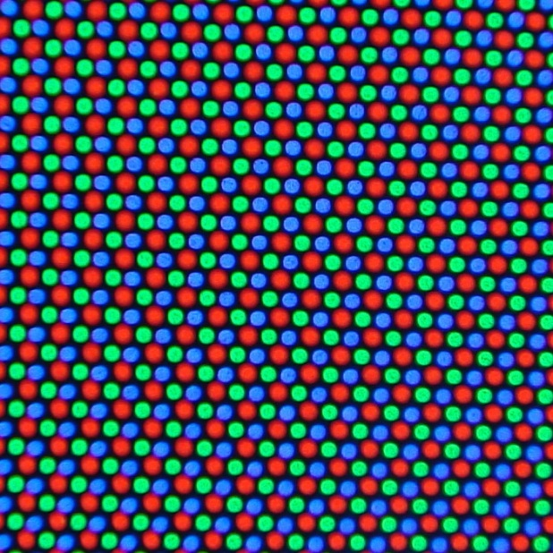
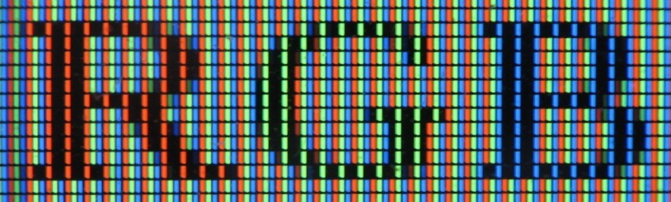
Pixels are not just “squares”
Close-up of an LCD screen
Close-up of a CRT screen

Slide 9
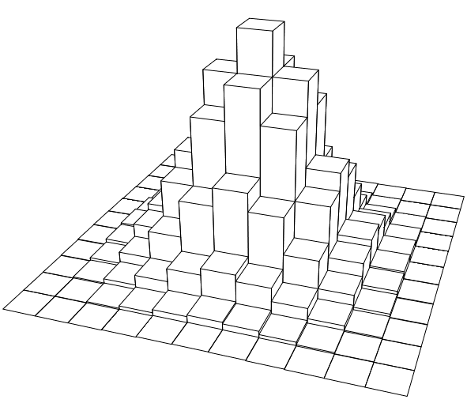
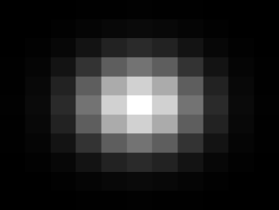
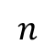
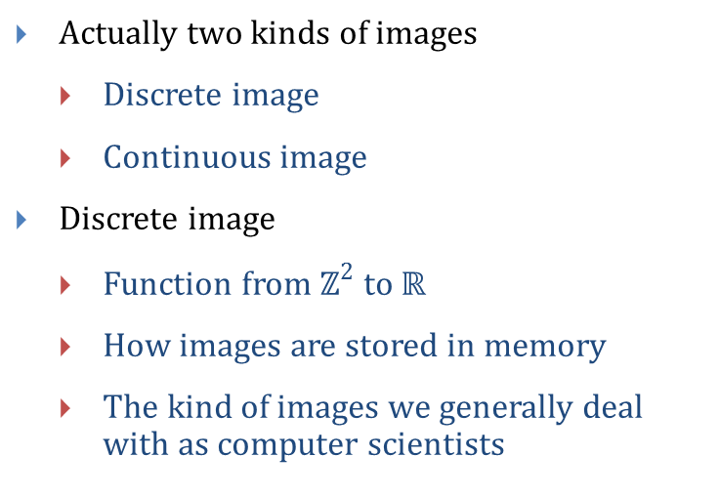
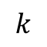
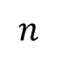

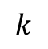
Discrete Images vs. Continuous Images
Actually two kinds of images
Discrete image
Continuous image
Discrete image
Function from $ℤ^{2}$ to $ℝ$
How images are stored in memory
The kind of images we generally deal with as computer scientists
$$n$$
$$k$$
$$k$$
$$n$$
Discrete image $u\left(i,j\right)$
Notes:
Images by Evan Wallace

Slide 10
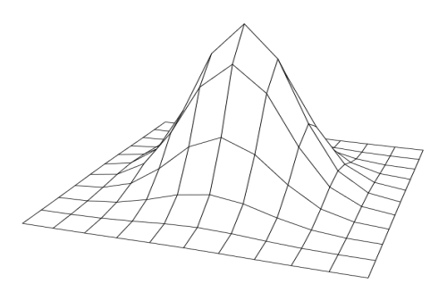
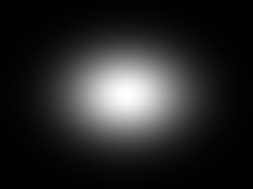
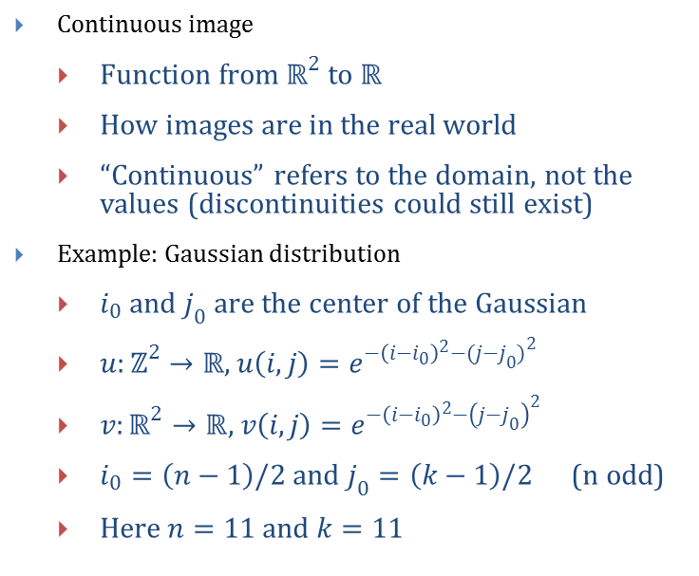
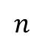
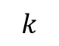
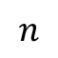
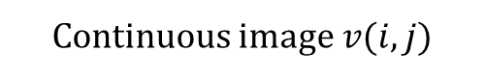
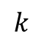
Discrete Images vs. Continuous Images
Continuous image
Function from $ℝ^{2}$ to $ℝ$
How images are in the real world
“Continuous” refers to the domain, not the values (discontinuities could still exist)
Example: Gaussian distribution
$i_{0}$ and $j_{0}$ are the center of the Gaussian
$u:ℤ^{2}→ℝ$, $u\left(i,j\right)=e^{−{\left(i−i_{0}\right)}^{2}−{(j−j_{0})}^{2}}$
$v:ℝ^{2}→ℝ$, $v\left(i,j\right)=e^{−{\left(i−i_{0}\right)}^{2}−{\left(j−j_{0}\right)}^{2}}$
$i_{0}=\left(n−1\right)/2$ and $j_{0}=\left(k−1\right)/2$ (n odd)
Here $n=11$ and $k=11$
$$n$$
$$k$$
$$k$$
$$n$$
Continuous image $v(i,j)$
Notes:
Images by Evan Wallace

Slide 11
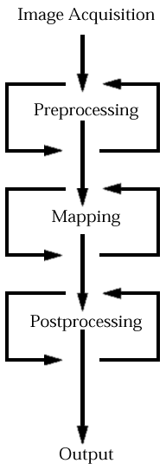
The Five Stages of Image Processing
The stages are
Image acquisisition – how we obtain images in the first place
Preprocessing – any effects applied before mapping (e.g. crop, mask, filter)
Mapping – catch-all stage involving image transformations or image composition
Postprocessing – any effects applied after mapping (e.g. texturizing, color remapping)
Output – printing or displaying on a screen
Stages are sometimes skipped
The middle stages are often interlaced

Slide 12
Stage 1: Image Acquisition
Image Synthesis
Images created by a computer
Painted in 2D
Corel Painter (website)
Photoshop (website)
Rendered from 3D geometry
Pixar’s RenderMan (website)
Autodesk’s Maya (website)
Your CS123 projects
Procedurally textured
Generated images intended to mimic their natural counterparts
E.g. procedural wood grain
Image Capture
Images from the “real world”
Information must be digitized from an analog signal
Common capture methods:
Digital camera
Satellite data
Drum scanner
Flatbed photo scanner
Frames from video

Slide 13

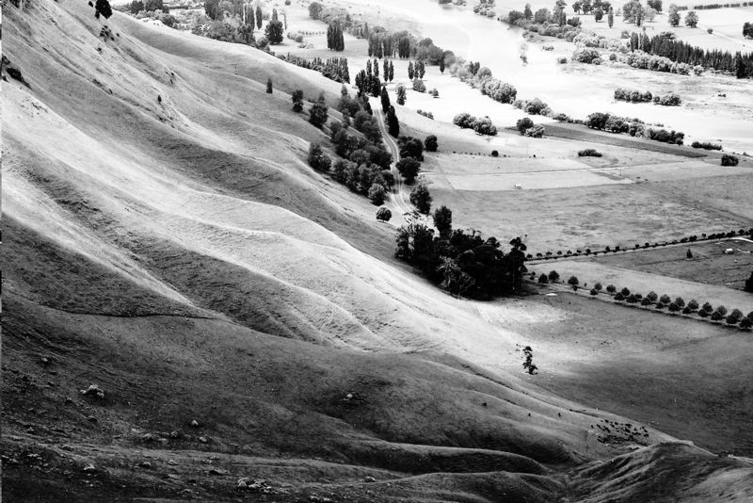
Stage 2: Preprocessing
Each source image is adjusted to fit a given tone, size, shape, etc., to match a desired quality or to match other images
Can make a set of dissimilar images appear similar (if they are to be composited later), or make similar parts of an image appear dissimilar (such as contrast enhancement)
Original
Adjusted grayscale curve
Notes:
Images from http://en.wikipedia.org/wiki/Histogram_equalization

Slide 14
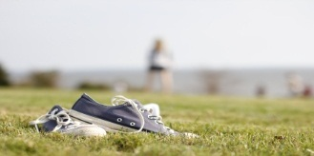
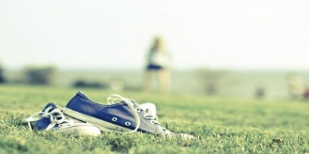


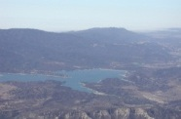
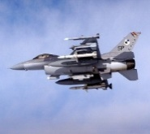
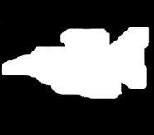
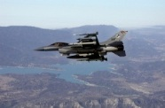
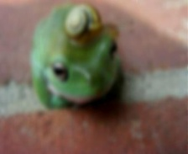
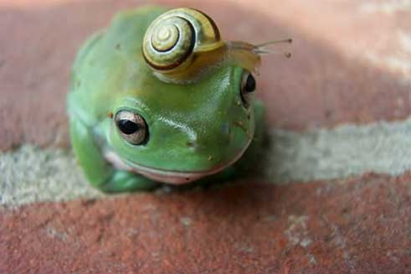
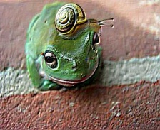
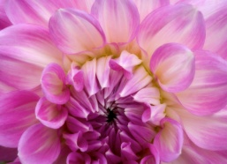
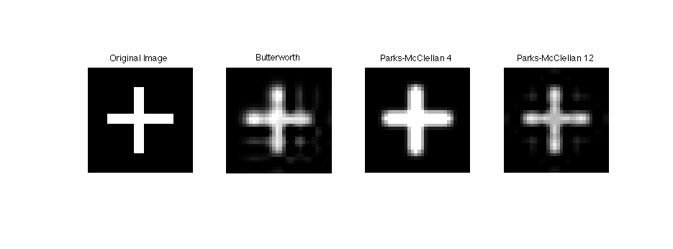
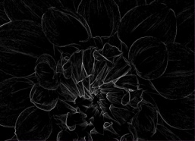
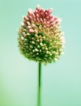
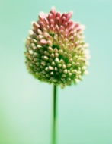

Stage 2: Preprocessing (continued)
Preprocessing techniques include:
Adjusting color or grayscale curve
Cropping
Masking (cutting out part of an image)
Blurring and sharpening
Edge detection/enhancement
Filtering and antialiasing
Scaling up (super sampling) or scaling down (sub sampling)

Slide 15
Stage 2: Preprocessing (continued)
Notes:
Blurring, sharpening, and edge detection can also be postprocessing techniques
Some preprocessing algorithms are not followed by mapping, others that involve resampling the image may be interlaced with mapping: filtering is done this way

Slide 16
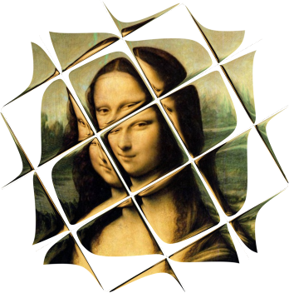
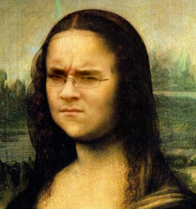
Stage 3: Mapping
Mapping is a catch-all stage where several images are combined, or geometric transformations are applied
Transformations include:
Rotating
Scaling
Shearing
Warping
Feature-based morphing
Compositing:
Basic image overlay
Smooth blending with alpha channels
Poisson image blending
Seamlessly transfers “details” (like edges) from part of one image to another
Image Warping
Poisson Image Blending
Image credit: © Evan Wallace 2010
Notes:
Images by Evan Wallace

Slide 17
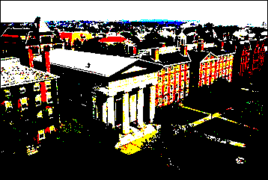
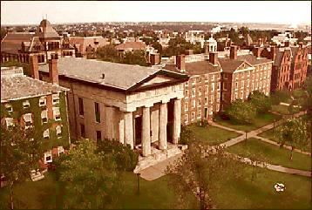
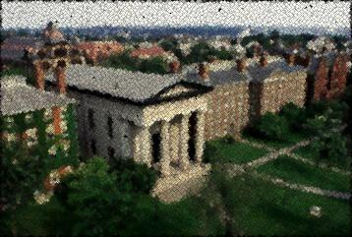
Stage 4: Postprocessing
Creates global effects across an entire image or selected area
Art effects
Posterizing
Faked “aging” of an image
Faked “out-of-focus”
“Impressionist” pixel remapping
Texturizing
Technical effects
Color remapping for contrast enhancement
Color to B&W conversion
Color separation for printing (RGB to CMYK)
Scan retouching and color/contrast balancing
Posterizing
Aging
Impressionist

Slide 18
Stage 5: Output (Archive/Display)
Choice of display/archive method may affect earlier processing stages
Color printing accentuates certain colors more than others
Colors on the monitor have different gamuts and HSV values than the colors printed out
Need a mapping
HSV = hue, saturation, value, a cylindrical coordinate system for the RGB color model
Gamut = set of colors that can be represented by output device/printer
Display Technologies
Monitor (CRT → LCD/LED/OLED/Plasma panel)
Color printer
Film/DVD
Disk file
Texture map for 3D renderer
Notes:
Image from http://commons.wikimedia.org/wiki/File:LCD_RGB.jpg

Slide 19
Outline
Overview
Example Applications
Jaggies & Aliasing
Sampling & Duals
Convolution
Filtering
Scaling
Reconstruction
Scaling, continued
Implementation

Slide 20
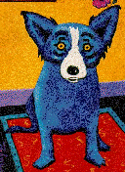
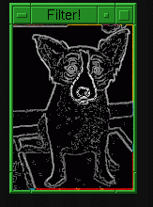
Example 1: Edge Detection Filtering
Edge detection filters measure the difference between adjacent pixels
A greater difference means a stronger edge
A threshold is sometimes used to remove weak edges
Sobel edge detection filter

Slide 21
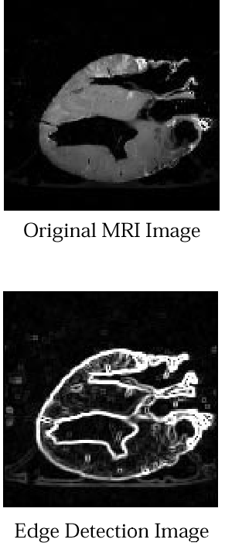
Example 1: Edge Detection Filtering (Continued)
Used with MRI scans to reveal boundaries between different types of tissues
MRI scan is image where gray level represents tissue density
Used same filter as previous slide
Original MRI image
of a dog heart
Image after
edge detection

Slide 22
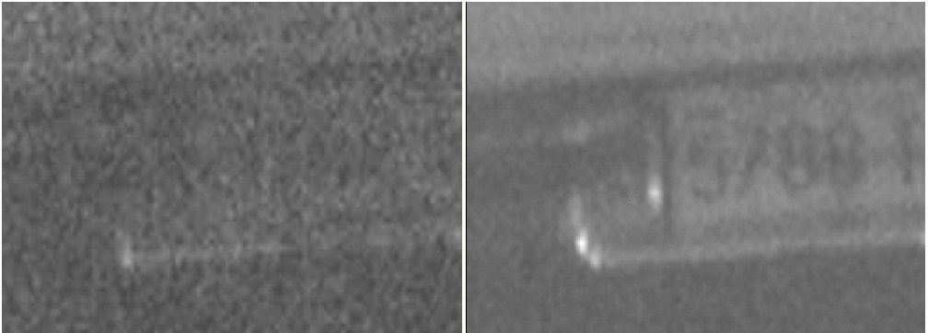
Example 2: Image Enhancement for Forensics
Extract evidence from seemingly incomprehensible images
Normally, image enhancement uses many filtering steps, and often no mapping at all
Michael Black and his class, CS296-4, received a commendation for helping Virginia police in a homicide case
Before enhancement
After enhancement
Notes:
Information on Michael Black’s Commendation:
http://www.cs.brown.edu/news/2007/0423.commendation.html
Images from http://www.ivimg.com/products/vcnvr.htm

Slide 23

Example 2: Image Enhancement for Forensics
We have a security camera video of the back of a car that was used in a robbery
The image is too dark and noisy for the police to pull a license number
Though humans can often discern an image of poor quality, filtering can make it easier for a pattern-recognition algorithm to decipher embedded symbols
Optical Character Recognition
Step 1: Get the frame from the videotape digitized with a frame-grabber

Slide 24

Example 2: Image Enhancement for Forensics
Step 2: Crop out stuff that appears to be uninteresting (outside plate edges)
This step can speed process by doing image processing steps on fewer pixels
Can’t always be done, may not be able to tell which sections are interesting without some processing

Slide 25

Example 2: Image Enhancement for Forensics
Step 3: Use edge-sharpening filter to add contrast to plate number
This step enhances edges by raising discontinuities at brightness gaps in image

Slide 26

Example 2: Image Enhancement for Forensics
Step 4: Remap colors to enhance contrast between numbers and plate itself
Now, can make a printout for records, or just copy plate number down: YNN-707!
Note that final colors do not even resemble real colors of license plate—enhancement techniques have seriously distorted the colors!

Slide 27
Multipart Composition
Image composition is popular in the art world, as well as in tabloid news
Takes parts of several images and creates single image
Hard part is making all images fit together naturally
Artists can use it to create amazing collages and multi-layered effects
Tabloid newspaper artists can use it to create “News Photos” of things that never happened – “Fauxtography”.
There is no visual truth in media!

Slide 28



Famous Faked Photos
Chinese press photo of Tibet railway
Tom Hanks and JFK

Slide 29


Example image composition (1/5)
Lars Bishop, former CS123 Head TA, created a news photo of himself “meeting” with former Russian President Boris Yeltsin
post-Gorbachev and Perestroika. He served 10 July 1991 – 31 December 1999, resigned in favor of Putin)
Needless to say, Lars Bishop never met Mr. Yeltsin
Had to get the images, cut out the parts he wanted, touch them up, paste them together, and retouch the end result
Image of Boris (from Internet)
Image of Lars (from video camera)

Slide 30


Example image composition (2/5)
Cut the pictures we want out of the original images
Paint a region around important parts of images (outline of people) using Photoshop
Continue touching up this outline until no background at edge of people
Use a smart lasso tool that grows until it hit the white background, thus selecting subject. (“Magic Wand” tool in photoshop can accomplish this)

Slide 31

Example image composition (3/5)
Filter the images to make them appear similar, and paste them together
Boris is blurred and brightened to get rid of the halftoning lines (must have been a magazine photo)
Lars is blurred and noise is added to match image quality to that of Boris
Images are resized so Boris and Lars are at similar scales

Slide 32
Example image composition (4/5)
Finalize image
Created a simple, two-color background and added noise so it fit with the rest of the image, placed cutout of the two subjects on top of background
This left a thin white halo around the subjects, so used a “Rubber Stamp” tool to stamp background noise patterns over halo, making seams appear less obvious

Slide 33

Example image composition (5/5)
Final Image (with retouching at edges)
BISHOP AND YELTSIN TALK PEACE
BISHOP: “I couldn’t understand a single word he said!”

Slide 34




Image Composition – Frankenface
Aseem Agarwala, Mira Dontcheva, Maneesh Agrawala, Steven Drucker, Alex Colburn, Brian Curless, David Salesin, Michael Cohen. Interactive Digital Photomontage. ACM Transactions on Graphics (Proceedings of SIGGRAPH 2004), 2004. http://grail.cs.washington.edu/projects/photomontage/

Slide 35




Image Composition – Frankenface
Aseem Agarwala, Mira Dontcheva, Maneesh Agrawala, Steven Drucker, Alex Colburn, Brian Curless, David Salesin, Michael Cohen. Interactive Digital Photomontage. ACM Transactions on Graphics (Proceedings of SIGGRAPH 2004), 2004. http://grail.cs.washington.edu/projects/photomontage/

Slide 36
Computer Vision (1/2)
Computer graphics is the business of using models to create images; computer vision solves the opposite problem—deriving models from images
Computer must do all the processing without human intervention
Often, processing techniques must be fast
Slow processing will add to camera-to-reaction latency (lag) in system
Common preprocessing techniques for computer vision:
Edge enhancement
Region detection
Contrast enhancement
Feature point detection
Notes:
Virtual Air Guitar project: http://airguitar.tml.hut.fi/photos.html

Slide 37
Computer Vision (2/2)
Image processing makes information easier to find
Pattern detection and pattern recognition are separate fields in their own right
Pattern detection: looking for features and describing the image’s content at a higher level
Pattern recognition: classifying collections of features and matching them against library of stored patterns. (e.g., alphanumeric characters, types of abnormal cells, or human features in the case of biometrics)
Pattern detection is one important component of pattern recognition
Computer vision can be used as part of a passive UI, as an alternative to intrusive (tethered) gadgetry such as 6DoF “space mice”, wands, and data gloves – see next slide
Computational photography draws on many techniques from vision
For more on computer vision: CS143 (computer vision), CS129 (computational photography). Also courses in DE, CLPS, ENGN

Slide 38

Example: Virtual Air Guitar
Real-time computer vision system
User wears orange gloves
Glove “regions” are extracted in real-time
Gesture recognition
Change note with upper hand
Strum with lower hand
Whenever hand crosses virtual guitar neck (diagonal line in picture)
Also vibrato and slide gestures
See this demonstration
The Virtual Air Guitar from
Helsinki University of Technology
Notes:
Virtual Air Guitar project: http://airguitar.tml.hut.fi/photos.html

Slide 39

Demo: Virtual Air Guitar

Slide 40


Microsoft Kinect
Uses computer vision to “see” your body’s shape
Extract multiple “skeletons” from depth image
Body as a controller
Gesture recognition
Facial recognition
Works with cheap hardware
RGB camera
CMOS depth sensor
Projected infrared pattern to see in darkness
Total cost $150
Current research uses Kinects to construct 3D point clouds
Joints of skeletons on top of depth map
The Kinect peripheral
Notes:
Images from http://xboxrepublic.top-forum.net/kinect-f26/is-this-how-microsoft-will-fix-kinect-s-couch-problem-t5510.htm and http://www.gamesradar.com/f/kinect-an-in-depth-look-at-how-it-works/a-20100819143229334005

Slide 41


3D Image Processing: (1/3)
3D images
3D image volumes from MRI scans need image processing
2D image processing techniques often have 3D analogs
Display becomes more difficult: voxels replace pixels (volumetric rendering)
Increases time and space complexity:
4 channel 1024x1024 image = 4 megs
4 channel 1024x1024x1024 image = 4 gigs!
$N^{2}$ processing algorithms become $N^{3}$
Illustration: Erlend Nagelhus and Gunnar Lothe.
3D MRI: Kyrre Eeg Emblem, Rikshospitalet, and Inge Rasmussen, Nidelven Hjerneforskningslaboratorium.

Slide 42




3D Image Processing: (2/3)
3D displays
Autostereoscopic displays starting to emerge
Most work with lenticular optics or parallax effects
We’ll revisit this in more detail later in the semester
Several companies are commercializing products
Philips released the first 3D HDTV in 2009, now 3D TVs are in many homes
Panasonic, LG, Samsung and Sony also have 3D TVs on the market
Hitachi, HTC, LG all produce 3D mobile phones
Nintendo 3DS
Philips 52” WOWvx Display
Hitachi H001
Nintendo 3DS

Slide 43


3D Image Processing: (3/3)
zSpace, an interactive 3D display and computing platform
http://zspace.com/about-zspace/
Potential applications include architecture, data visualization, medicine, digital art, engineering, gaming/entertainment, education
Fujifilm 3D technology
FinePix REAL 3D, released in 2009, captures video and images in 3D
3D printing service

Slide 44
Outline
Overview
Example Applications
Jaggies & Aliasing (next class)
Sampling & Duals
Convolution
Filtering
Scaling
Reconstruction
Scaling, continued
Implementation

